Slide 1
Blackstone Metro district community improvement survey results

Slide 2
Survey Topics
Length You’ve Lived in BSM
Capital Project Options
Drought-Friendly Landscape
Public Infrastructure
Outdoor & Landscape
Lighting Results
Funding/Investing
Blackstone Country Club Membership Level
Park Cleanliness
Amenity Usage Results
Additional Facilities Options

Slide 3
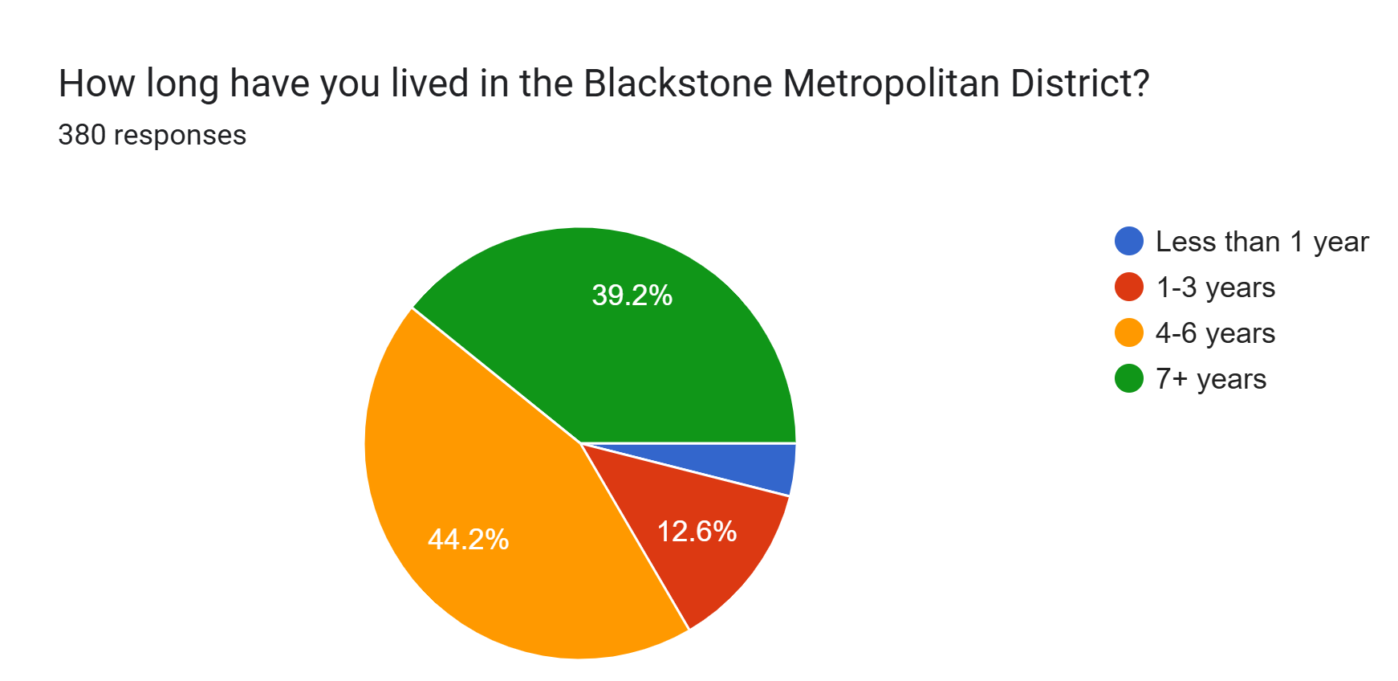
Length of time in Blackstone.

Slide 4
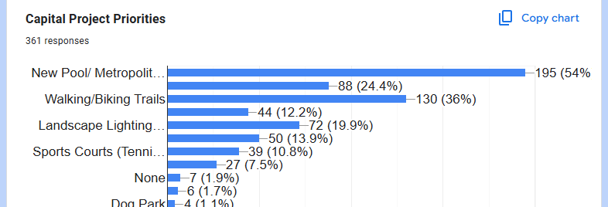
Capital projects

Slide 5
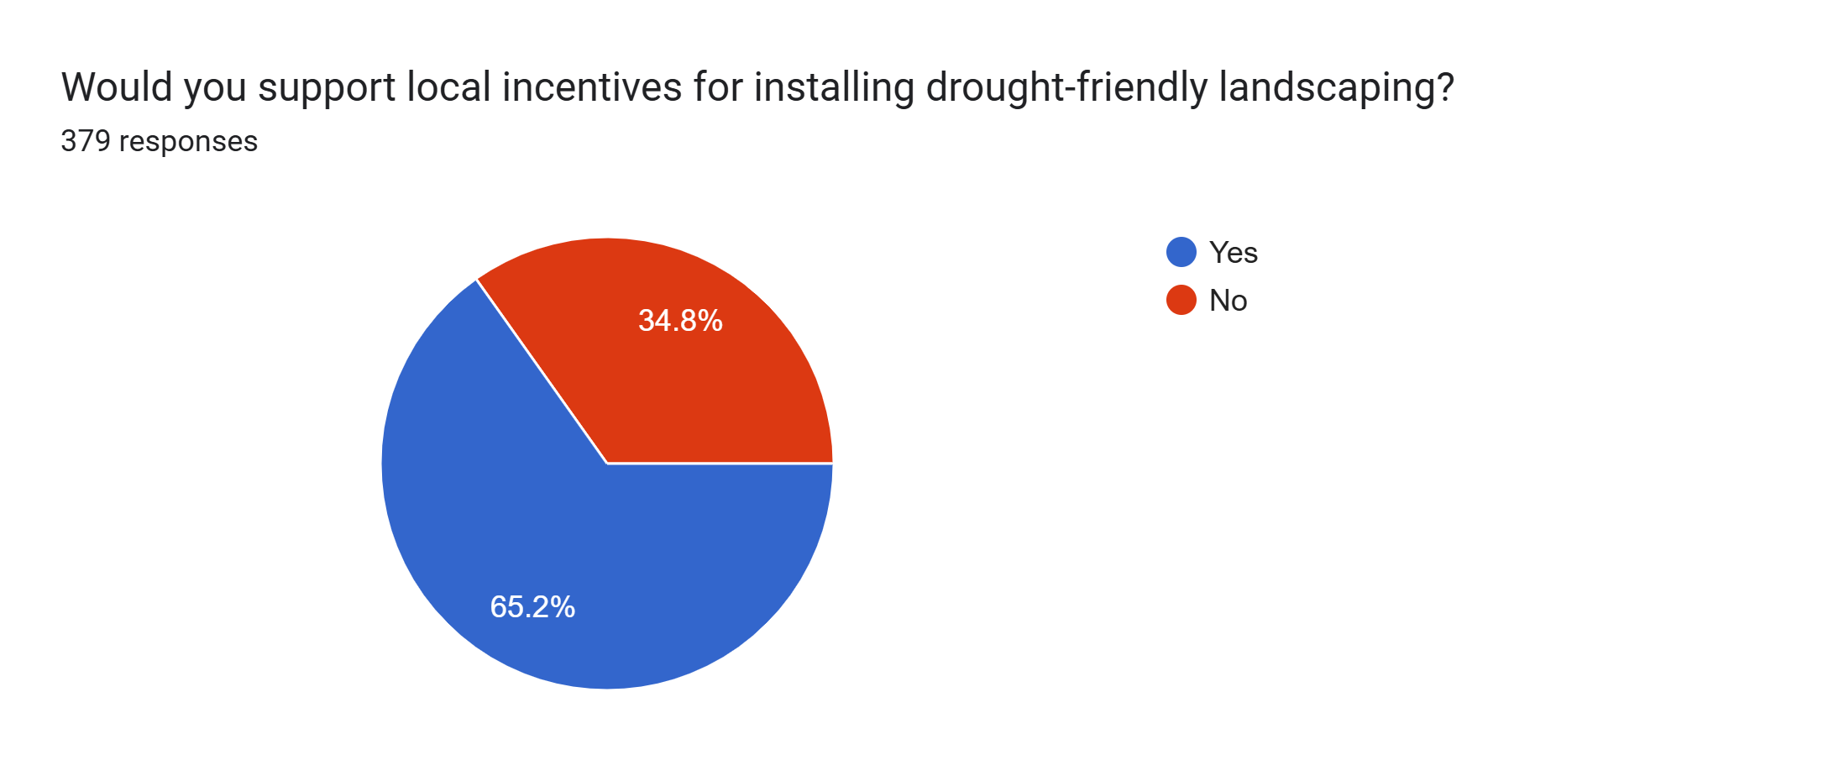
Support Incentives for drought-friendly landscaping.

Slide 6
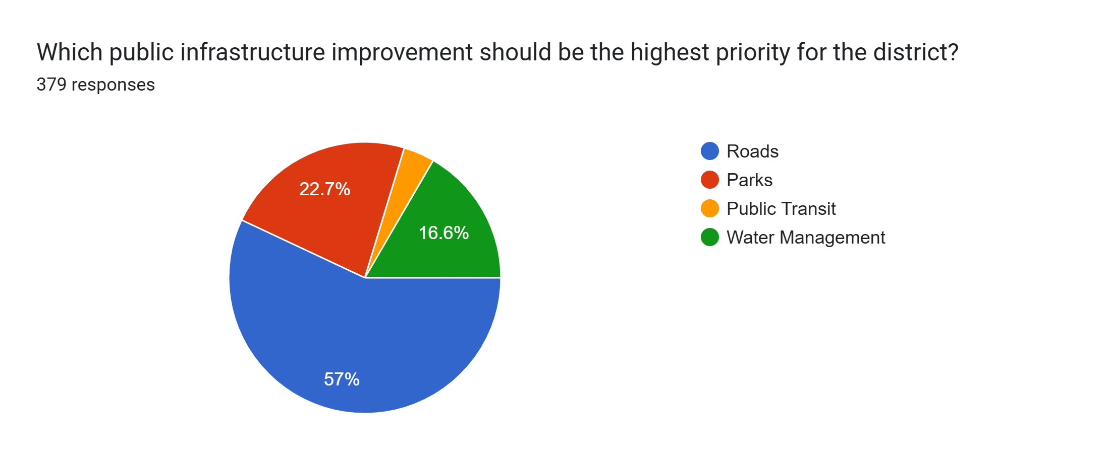
Infrastructure Improvement options

Slide 7
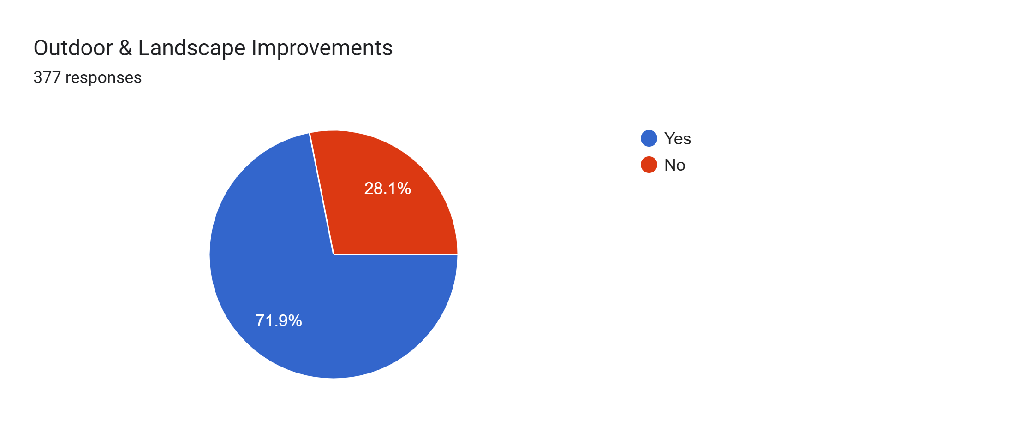
Outdoor & landscaping improvements

Slide 8
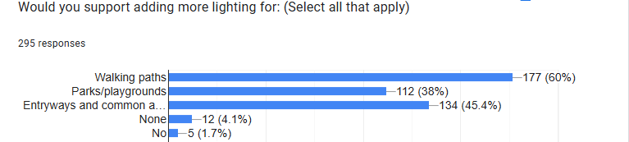
Support for more Lighting

Slide 9
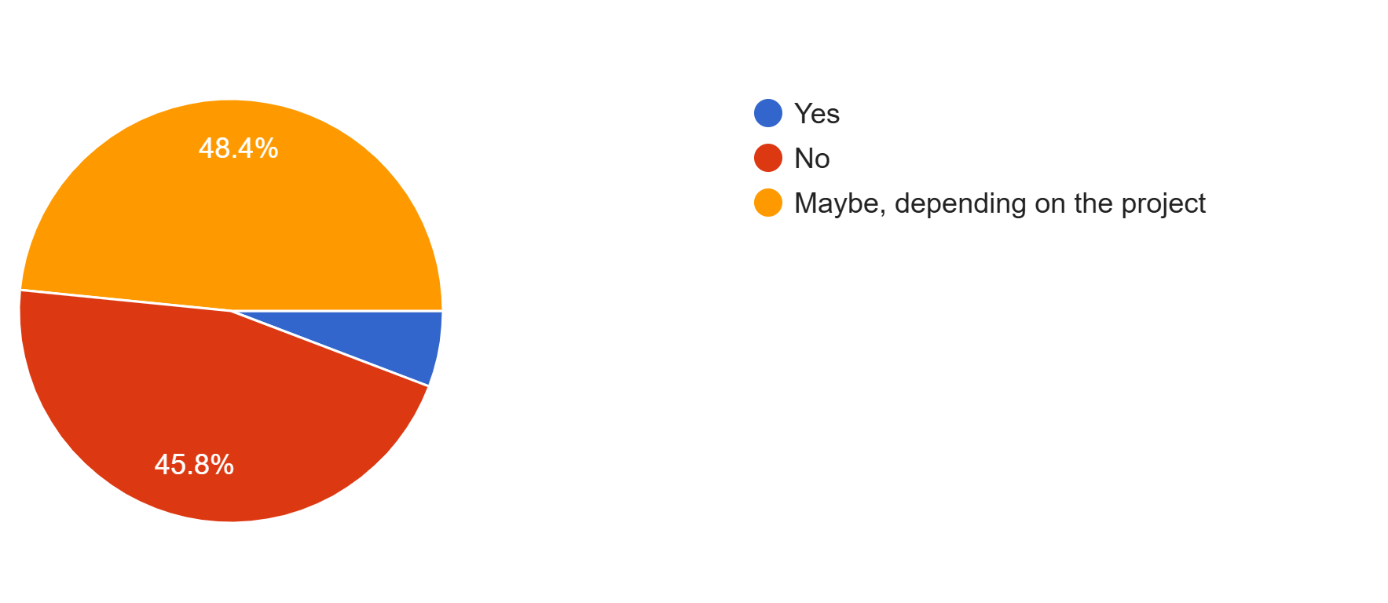
Funding & investment option

Slide 10
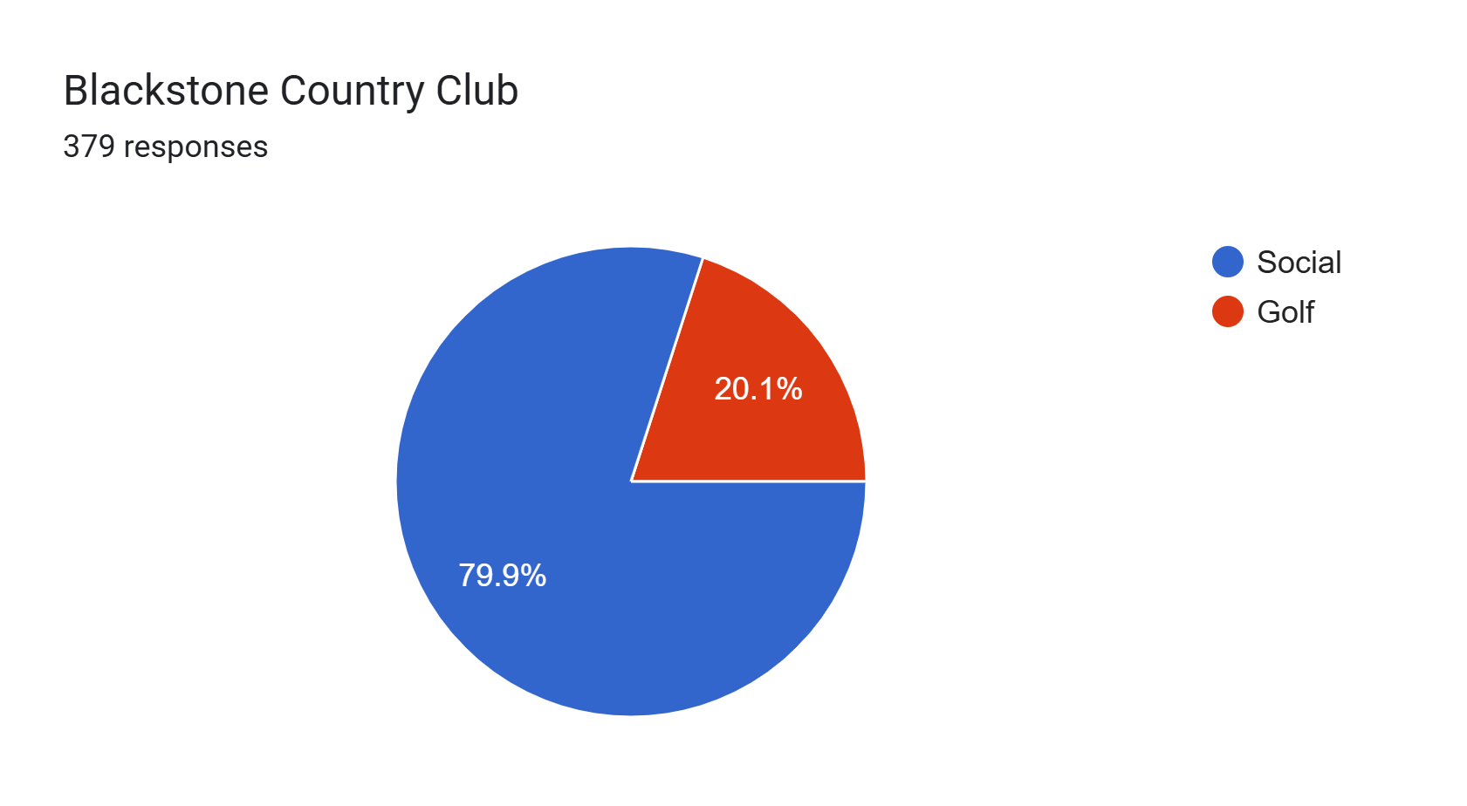
Blackstone Club membership level

Slide 11
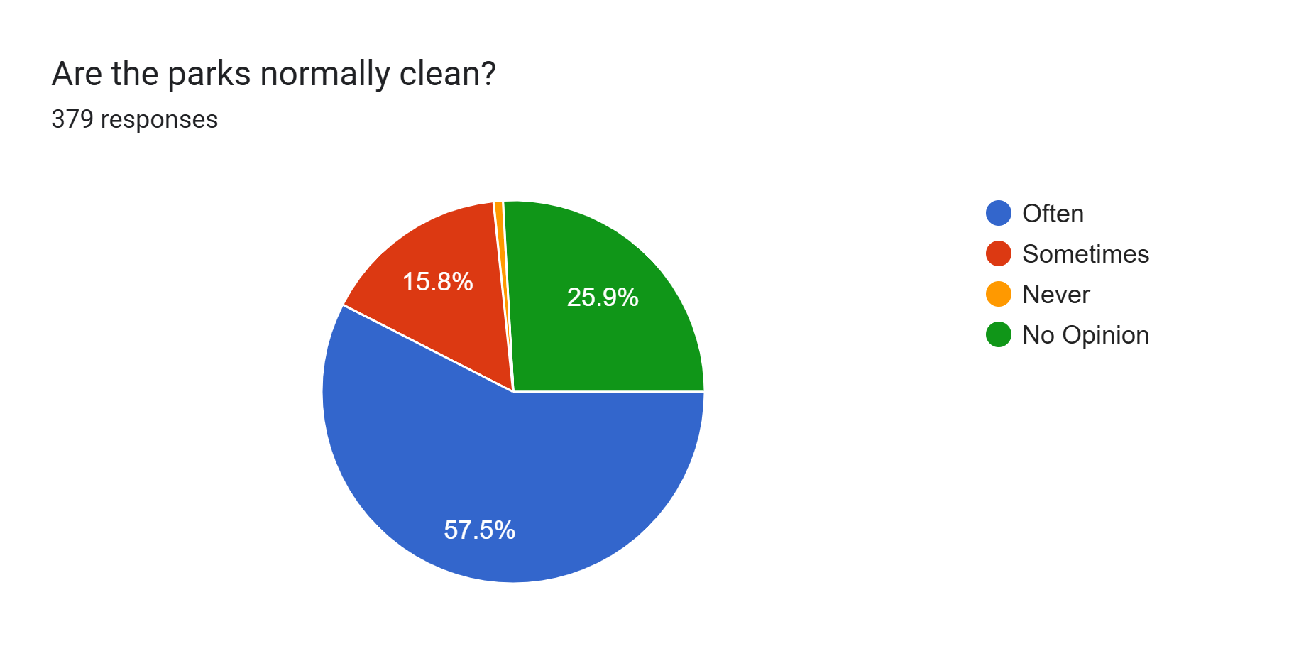
Park cleanliness

Slide 12
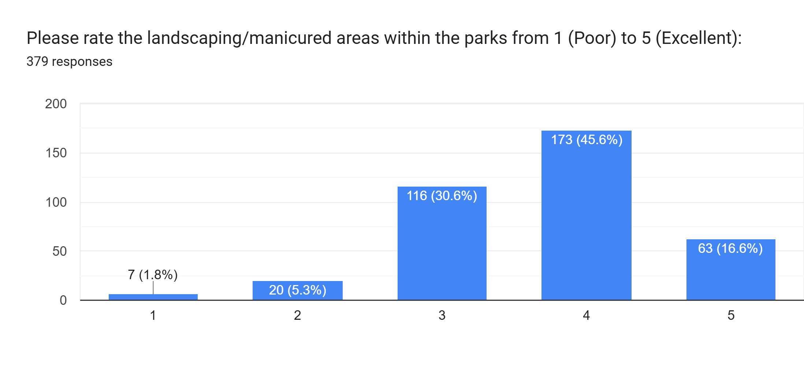
Rating of landscaping/manicured areas

Slide 13
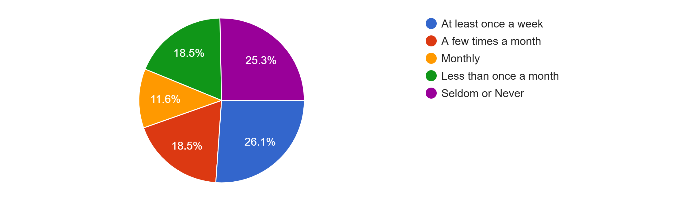
How often do you visit a park within Blackstone?

Slide 14
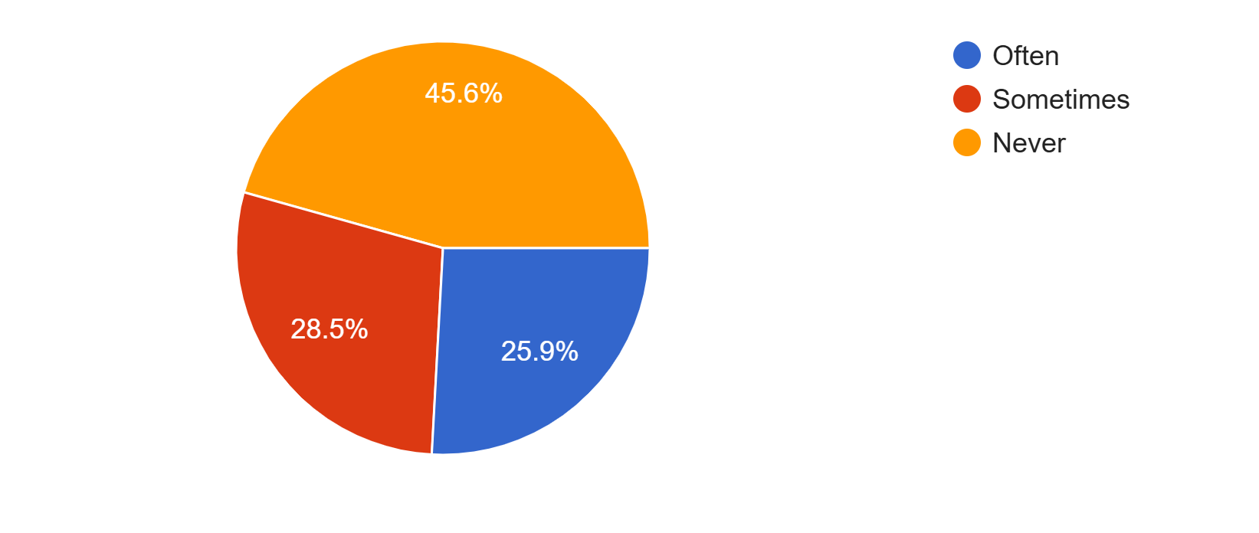
Do you and your family use the play equipment at the parks?

Slide 15
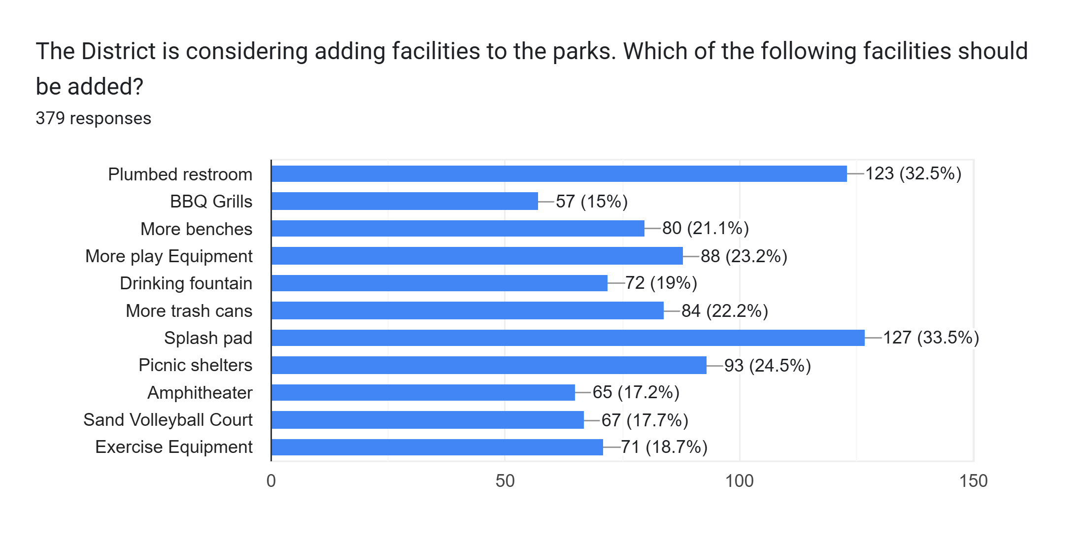
Added facilities to parks options.

